Slide 1
Tutorial 10 Incentive compensation

Slide 2
Unit of Study Survey (USS)
The Unit of Study Survey (USS) for ECON5026 is now open!
How to make your USS feedback count
Your Unit of Study Survey (USS) feedback is confidential.
It’s a way to share what you enjoyed and found most useful in your learning, and to provide constructive feedback. It’s also a way to ‘pay it forward’ for the students coming behind you, so that their learning experience in this class is as good, or even better, than your own.
When you complete your USS survey (https://student-surveys.sydney.edu.au), please:
Be relevant.
Imagine you are the teacher. What sort of feedback would you find most useful to help make your teaching more effective?
Be constructive.
What practical changes can you suggest to class tasks, assessments or other activities, to help the next class learn better?
Be specific.
Which class tasks, assessments or other activities helped you to learn? Why were they helpful? Which one(s) didn’t help you to learn? Why didn’t they work for you?

Slide 3
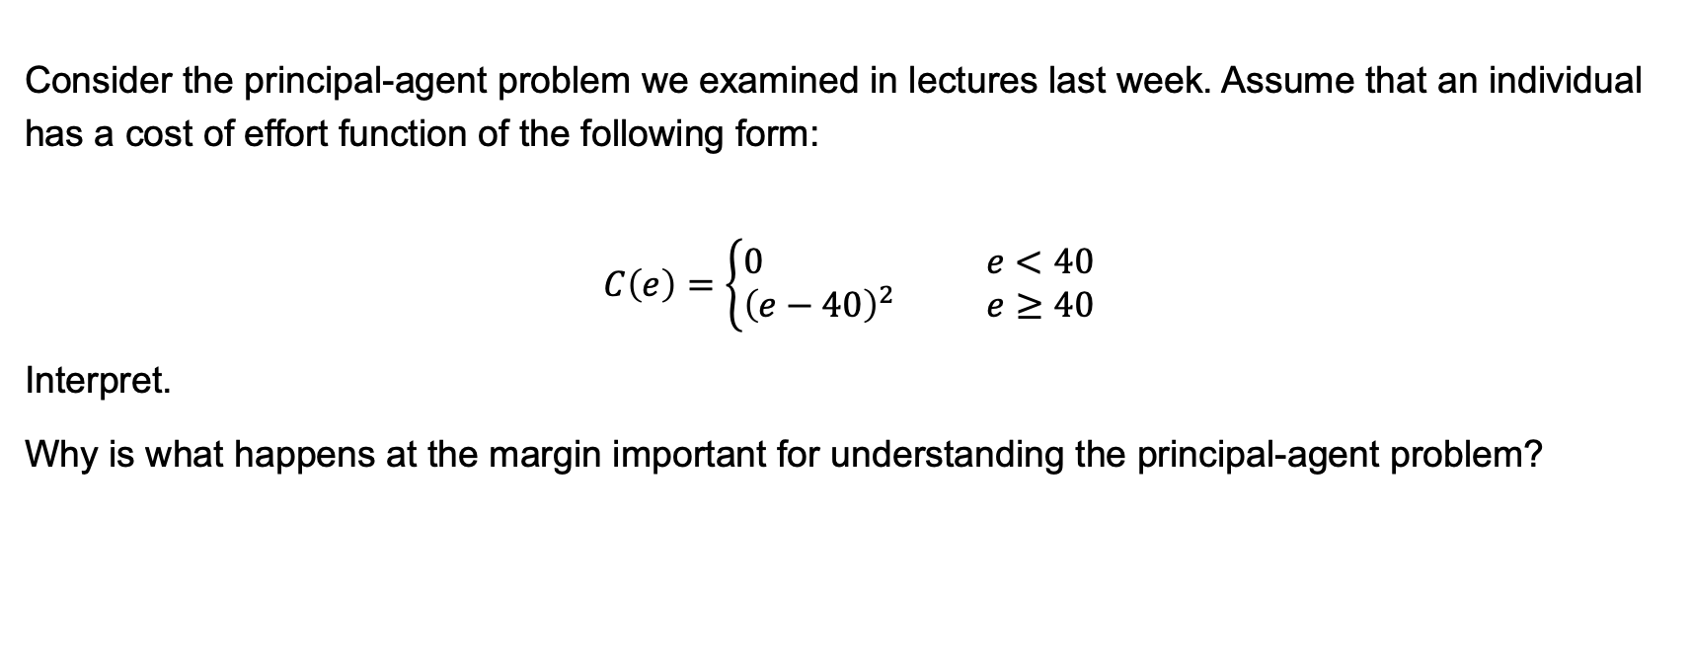
QUESTION 2
Consider the principal-agent problem we examined in lectures last week. Assume that an individual has a cost of effort function of the following form:
$$C\left(e\right)=\left\{\begin{aligned}0 e<40 \\ {\left(e−40\right)}^{2} e≥40\end{aligned}\right.$$
Interpret.
Why is what happens at the margin important for understanding the principal-agent problem?

Slide 4
QUESTION 2

Slide 5
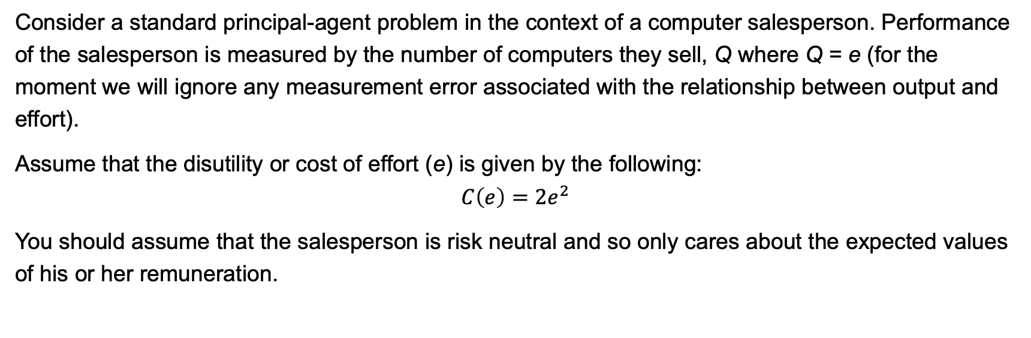
QUESTION 3
Consider a standard principal-agent problem in the context of a computer salesperson. Performance of the salesperson is measured by the number of computers they sell, Q where Q = e (for the moment we will ignore any measurement error associated with the relationship between output and effort).
Assume that the disutility or cost of effort (e) is given by the following:
$$C\left(e\right)=2e^{2}$$
You should assume that the salesperson is risk neutral and so only cares about the expected values of his or her remuneration.

Slide 6
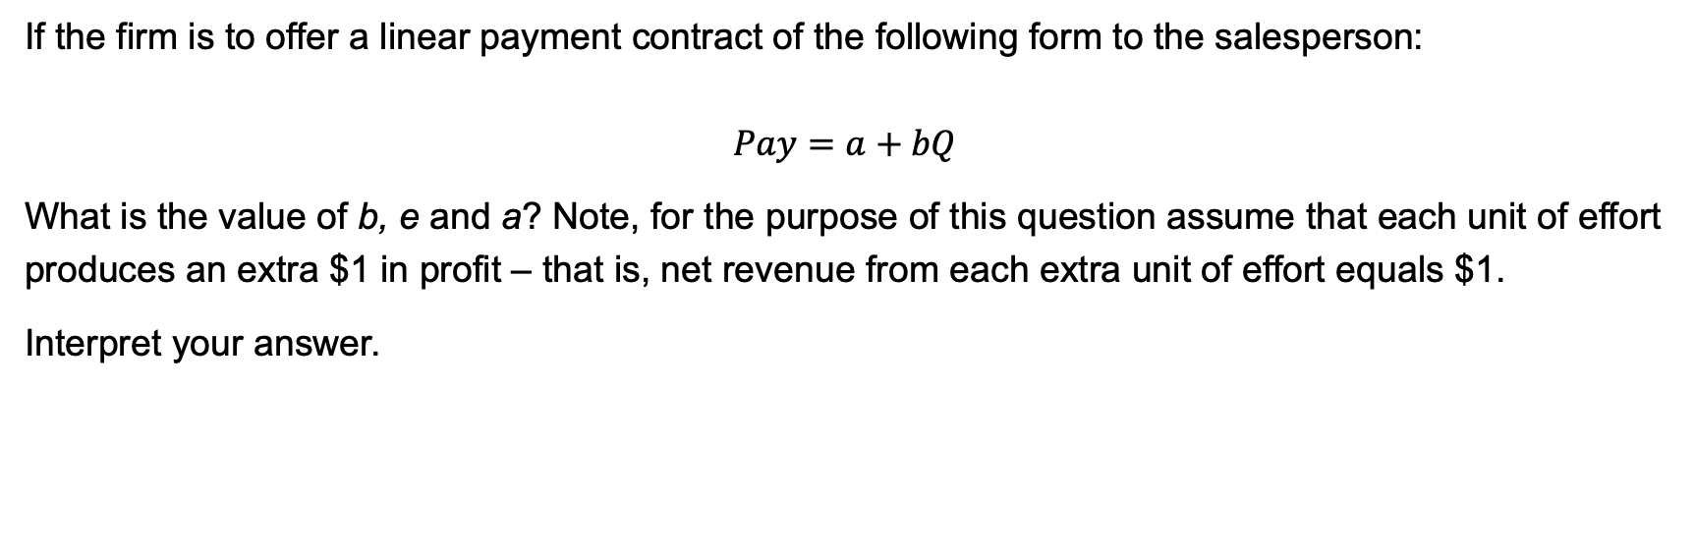
QUESTION 3
If the firm is to offer a linear payment contract of the following form to the salesperson:
$$Pay=a+bQ$$
What is the value of b, e and a? Note, for the purpose of this question assume that each unit of effort produces an extra $1 in profit – that is, net revenue from each extra unit of effort equals $1.
Interpret your answer.

Slide 7
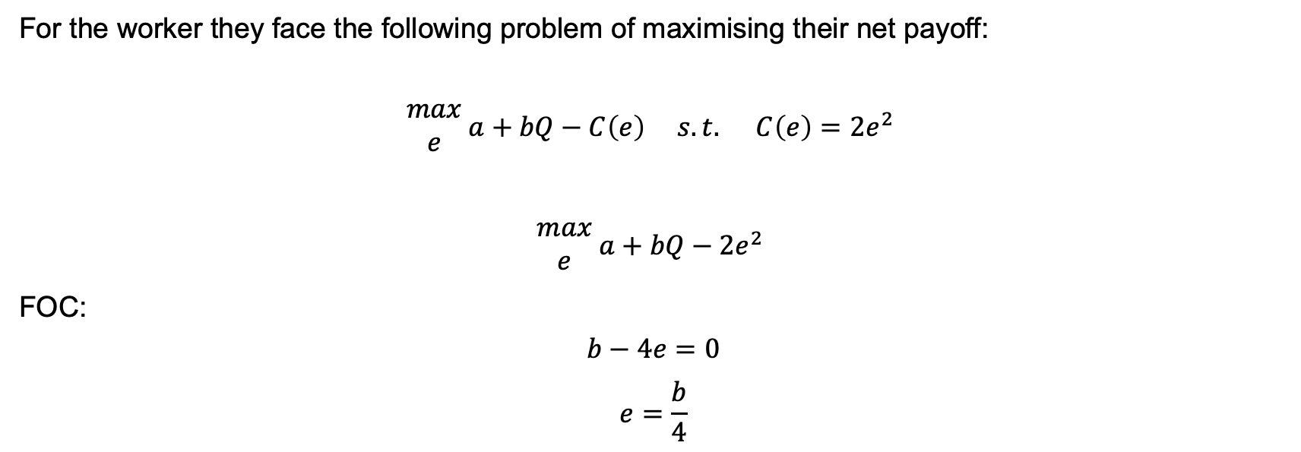
QUESTION 3
For the worker they face the following problem of maximising their net payoff:
$$\begin{matrix}max \\ e\end{matrix} a+bQ−C\left(e\right) s.t. C\left(e\right)=2e^{2}$$
$$\begin{matrix}max \\ e\end{matrix} a+bQ−2e^{2}$$
FOC:
$$b−4e=0$$
$$e=\frac{b}{4}$$

Slide 8
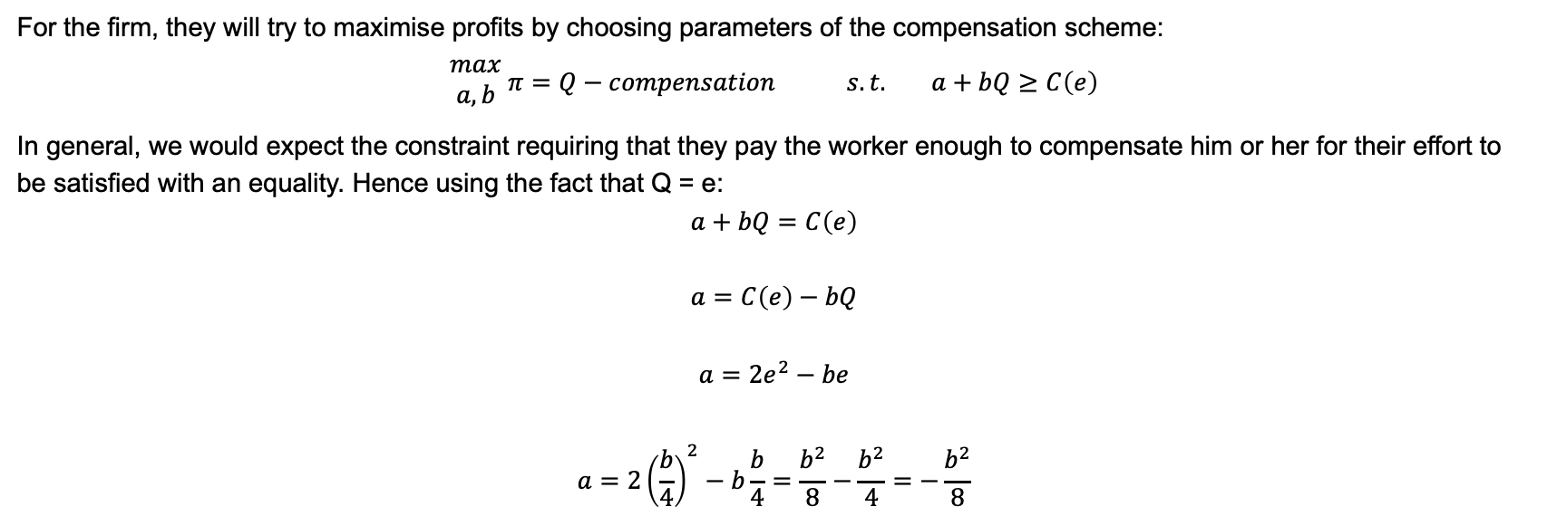
QUESTION 3
For the firm, they will try to maximise profits by choosing parameters of the compensation scheme:
$$\begin{matrix}max \\ a,b\end{matrix} π=Q−compensation s.t. a+bQ≥C\left(e\right)$$
In general, we would expect the constraint requiring that they pay the worker enough to compensate him or her for their effort to be satisfied with an equality. Hence using the fact that Q = e:
$$a+bQ=C\left(e\right)$$
$$a=C\left(e\right)−bQ$$
$$a=2e^{2}−be$$
$$a=2{\left(\frac{b}{4}\right)}^{2}−b\frac{b}{4}=\frac{b^{2}}{8}−\frac{b^{2}}{4}=−\frac{b^{2}}{8}$$

Slide 9
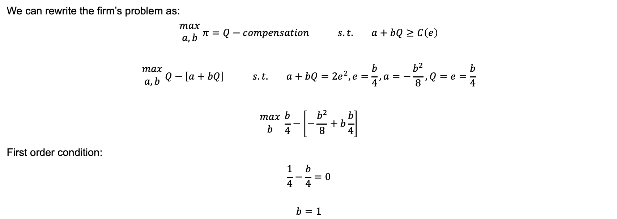
QUESTION 3
We can rewrite the firm’s problem as:
$$\begin{matrix}max \\ a,b\end{matrix} π=Q−compensation s.t. a+bQ≥C\left(e\right)$$
$$\begin{matrix}max \\ a,b\end{matrix} Q−\left[a+bQ\right] s.t. a+bQ=2e^{2}, e=\frac{b}{4}, a=−\frac{b^{2}}{8}, Q=e=\frac{b}{4}$$
$$\begin{matrix}max \\ b\end{matrix} \frac{b}{4}−\left[−\frac{b^{2}}{8}+b\frac{b}{4}\right]$$
First order condition:
$$\frac{1}{4}−\frac{b}{4}=0$$
$$b=1$$

Slide 10
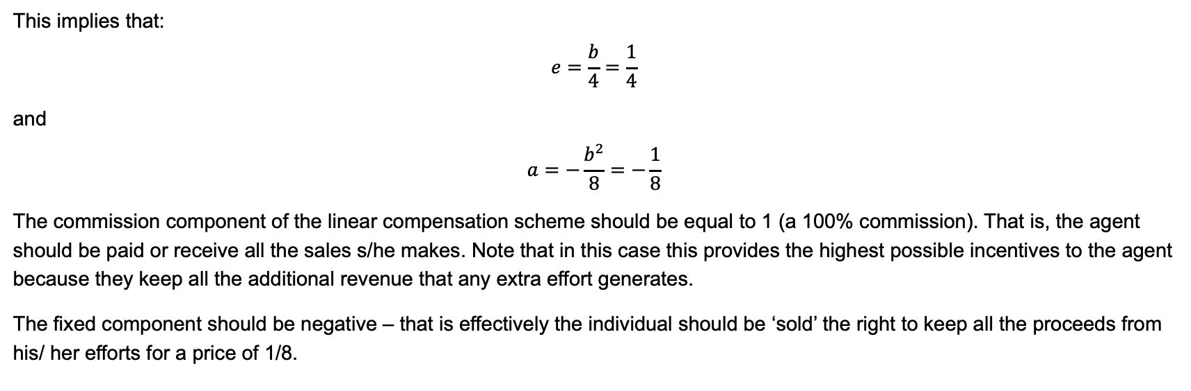
QUESTION 3
This implies that:
$$e=\frac{b}{4}=\frac{1}{4}$$
and
$$a=−\frac{b^{2}}{8}=−\frac{1}{8}$$
The commission component of the linear compensation scheme should be equal to 1 (a 100% commission). That is, the agent should be paid or receive all the sales s/he makes. Note that in this case this provides the highest possible incentives to the agent because they keep all the additional revenue that any extra effort generates.
The fixed component should be negative – that is effectively the individual should be ‘sold’ the right to keep all the proceeds from his/ her efforts for a price of 1/8.

Slide 11
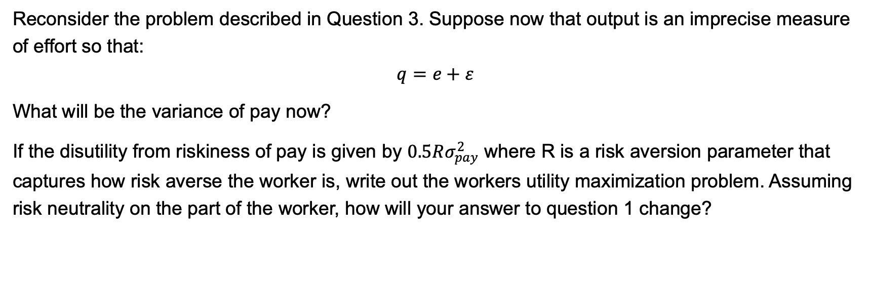
QUESTION 4
Reconsider the problem described in Question 3. Suppose now that output is an imprecise measure of effort so that:
$$q=e+ε$$
What will be the variance of pay now?
If the disutility from riskiness of pay is given by $0.5Rσ_{pay}^{2}$ where R is a risk aversion parameter that captures how risk averse the worker is, write out the workers utility maximization problem. Assuming risk neutrality on the part of the worker, how will your answer to question 1 change?

Slide 12
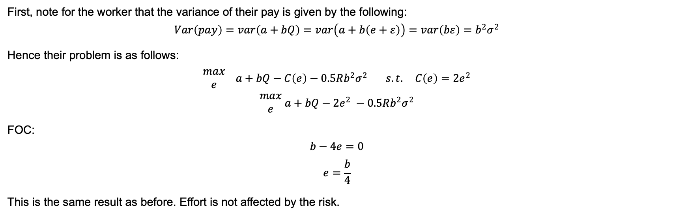
QUESTION 4
First, note for the worker that the variance of their pay is given by the following:
$$Var\left(pay\right)=var\left(a+bQ\right)=var\left(a+b\left(e+ε\right)\right)=var\left(bε\right)=b^{2}σ^{2}$$
Hence their problem is as follows:
$$\begin{matrix}max \\ e\end{matrix} a+bQ−C\left(e\right)−0.5Rb^{2}σ^{2} s.t. C\left(e\right)=2e^{2}$$
$$\begin{matrix}max \\ e\end{matrix} a+bQ−2e^{2} −0.5Rb^{2}σ^{2}$$
FOC:
$$b−4e=0$$
$$e=\frac{b}{4}$$
This is the same result as before. Effort is not affected by the risk.

Slide 13
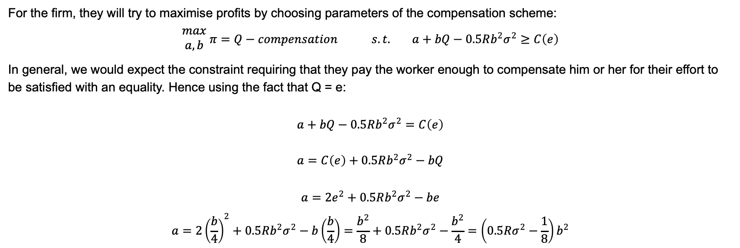
QUESTION 4
For the firm, they will try to maximise profits by choosing parameters of the compensation scheme:
$$\begin{matrix}max \\ a,b\end{matrix} π=Q−compensation s.t. a+bQ−0.5Rb^{2}σ^{2}≥C\left(e\right)$$
In general, we would expect the constraint requiring that they pay the worker enough to compensate him or her for their effort to be satisfied with an equality. Hence using the fact that Q = e:
$$a+bQ−0.5Rb^{2}σ^{2}=C\left(e\right)$$
$$a=C\left(e\right)+0.5Rb^{2}σ^{2}−bQ$$
$$a=2e^{2}+0.5Rb^{2}σ^{2}−be$$
$$a=2{\left(\frac{b}{4}\right)}^{2}+0.5Rb^{2}σ^{2}−b\left(\frac{b}{4}\right)=\frac{b^{2}}{8}+0.5Rb^{2}σ^{2}−\frac{b^{2}}{4}=\left(0.5Rσ^{2}−\frac{1}{8}\right)b^{2}$$

